Slide 1
Mutual Exclusion in Networks

Slide 2
Shared Objects
Common variable or datastructure:
Needs to be accessed, but not concurrently! How?

Slide 3
Shared Objects
Idea: store at central location, e.g., root of spanning tree
Access: send message to root, root processes request,
result sent back down the tree.

Slide 4
Shared Objects
Idea: store at central location, e.g., root of spanning tree
Analysis?
Access: send message to root, root processes request,
result sent back down the tree.

Slide 5
Shared Objects
Idea: store at central location, e.g., root of spanning tree
Could improve many things:
Don’t go via Spanning Tree, but route directly.
If same node v needs object again and again, it would be better if v can have the object!
Access: send message to root, root processes request,
result sent back down the tree.

Slide 6
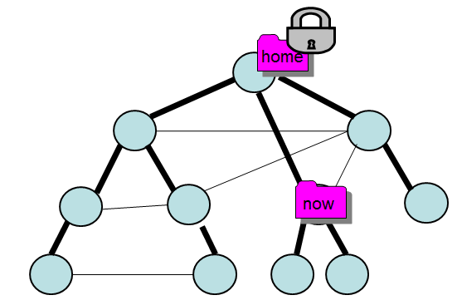
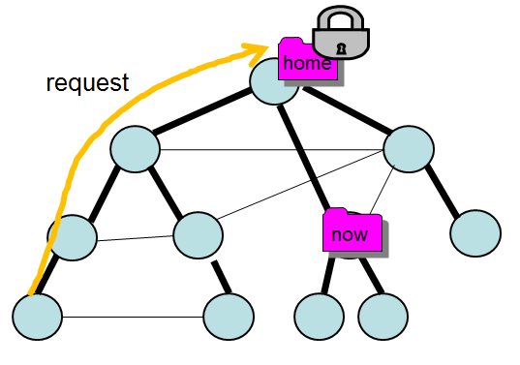
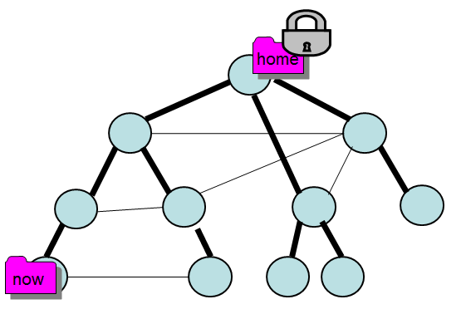
Home-Based Solution
Idea that object has «home base»:
- processes get lock from there
- then retrieve object and process locally!
Similar to Mobile IP!
1.
2.
3.

Slide 7
Home-Based Solution
Idea that object has «home base»:
- processes get lock from there
- then retrieve object and process locally!
Similar to Mobile IP!
1.
2.
3.
Problem?

Slide 8
Home-Based Solution
Idea that object has «home base»:
- processes get lock from there
- then retrieve object and process locally!
Similar to Mobile IP!
1.
2.
3.
Have to go via root - triangle routing:
if two alternating accessing nodes are close but root is far.

Slide 9
The Arrow Protocol
Idea: Make accessor responsible for object, i.e. the new «root».
How can this be achieved?
9

Slide 10
The Arrow Protocol
Idea: Make accessor responsible for object, i.e. the new «root».
(1) Make tree directed
now
I want
access!
10

Slide 11
The Arrow Protocol
Idea: Make accessor responsible for object, i.e. the new «root».
(1) Make tree directed
now
find()
I want
access!
11

Slide 12
The Arrow Protocol
Idea: Make accessor responsible for object, i.e. the new «root».
Make tree directed
Give object to accessor, new root!
now
12

Slide 13
The Arrow Protocol
Idea: Make accessor responsible for object, i.e. the new «root».
Make tree directed
Give object to accessor, new root!
Invert pointers along the find path in spanning tree!
now
13

Slide 14
Arrow: What about concurrency?
14

Slide 15
Arrow: What about concurrency?
now
I want
access!
15

Slide 16
Arrow: What about concurrency?
still in use!
now
wait()
16

Slide 17
Arrow: What about concurrency?
Idea: when searching,
reverse links, so other nodes
will find end of queue!
now
wait()
17

Slide 18
Arrow: What about concurrency?
still in use!
now
wait()
I want access!
18

Slide 19
Arrow: What about concurrency?
still in use!
now
wait()
I want access!
Follow direction of links to find
end of queue (predecessor)!
19

Slide 20
Arrow: What about concurrency?
still in use!
now
u
v
wait()
succ=v
Also reverse links
and wait()
Perfect: tree automatically rooted at node v now! Distributed queue.
Node u can just send it directly to v («out-of-band») when done.

Slide 21
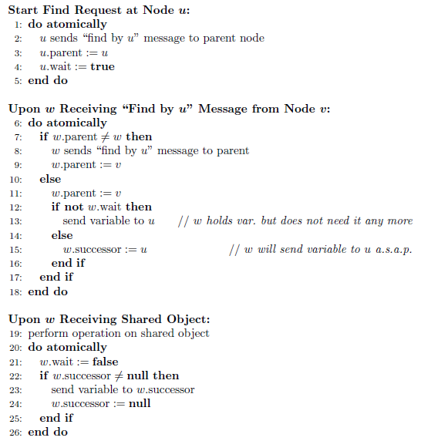
Arrow
invert edge!
wait myself?

Slide 22
Analysis
Arrow
Arrow is correct: find() terminates with message and time
complexity D, where D is the diameter of the spanning tree.
Completely asynchronous and concurrent environments!
Proof.
Each edge {u,v} in the spanning tree is in one of four states:
(A) u points to v, no message on the edge, v does not point to u
(B) Message on the move from u to v (no pointer along edge)
(C) v points to u, no message on edge, u does not point to v
Message on the move from v to u (no pointer along edge)
So message will only travel on static tree!
And can never traverse an edge twice (in opposite direction).
QED
22

Slide 23
End of Lecture
23

